Slide 1
Lab 5

Slide 2
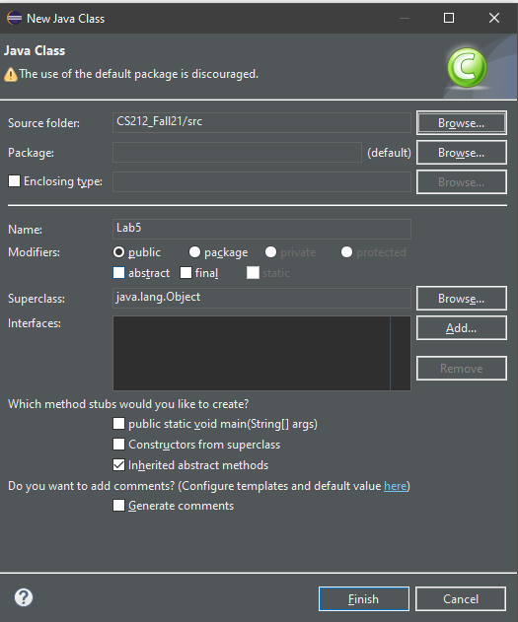
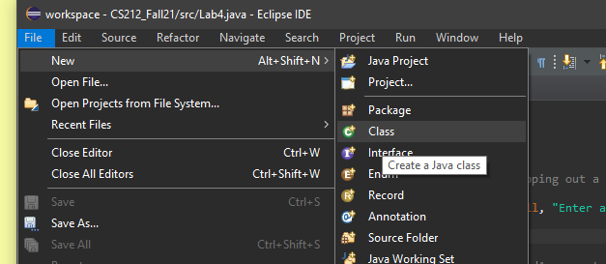
Step 1
Create a Lab5 class in eclipse

Slide 3
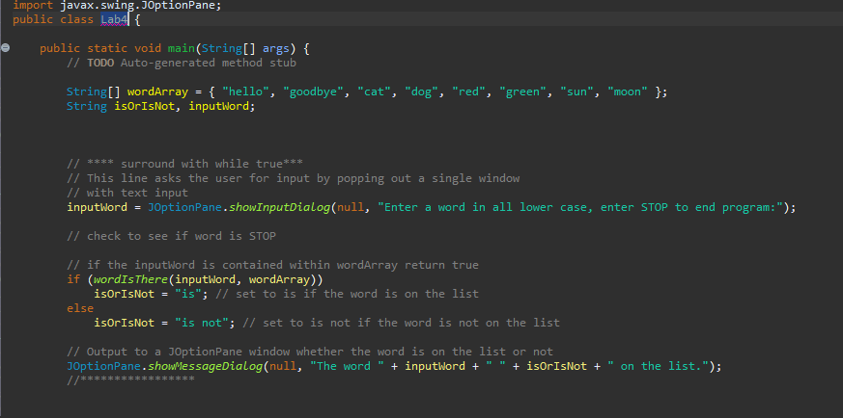
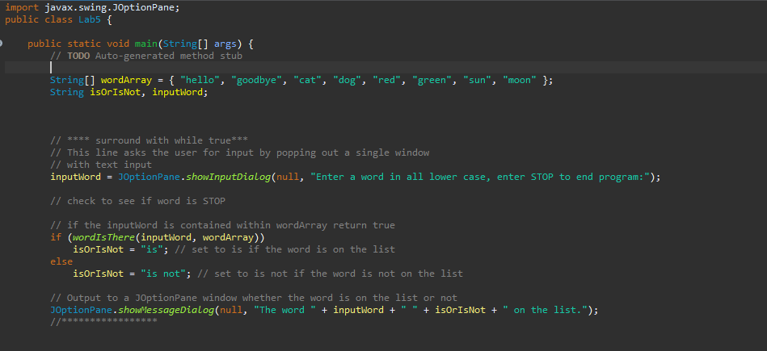
Step 1
Copy over the entirety of your Lab4 to Lab5 and change public class Lab4 {… to public class Lab5

Slide 4
Step 2
Create a text file named lab5input somewhere in your pc and copy the directory to the text file
We will pass this file address to the program via eclipse

Slide 5
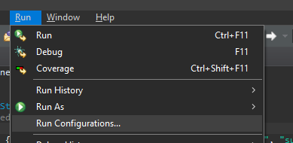

Step 1 – passing command line argument through eclipse
Add command line argument
To do this click on run and click run configurations
Click on arguments in the window that pops up
Copy and paste the directory for your text file and add /lab5input.txt at the end into program arguments hit apply and close the popup

Slide 6
Step 1 – check argument
Check to see if you did it right if you add a line System.out.println(args[0]); to the top of your program the console should print filepath/lab5input.txt relative to the path for your file
You can remove or comment out the line once you check

Slide 7
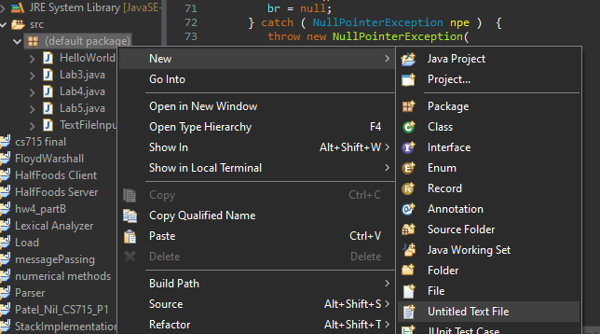
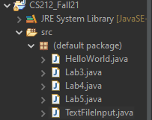
Step 1
We will also need to add a file to the src folder as well as the TextFileInput.java file provided
Drag and drop the TextFileInput.java file into the default package under src

Slide 8

Step 2
Add words to your text file each word on a new line, at the top of the file enter the number of words in the file

Slide 9
Step 3
Now we need a method that will create a string array from the text file, we can put this method in the TextFileInput.java program
Your method should have a return type of String[] it should return an array of strings, you want to read the first line and save it as an integer value
Public String[] returnArray{}
Declare a String array with and initial length that is the integer you just got
Using a loop you should fill the array with the words in the file

Slide 10
Step 3 – useful Syntax
In TextFileInput br.readLine(); will read the next line
The above line returns a string to convert to an int use Integer.valueOf(string);

Slide 11
Step 3 – updating Lab5.java
You will want to comment out the line that makes String[] wordArray or delete it all together
First you will have to create a TextFileInput object using:
TextFileInput lab5input = new TextFileInput(args[0]);
The general syntax for declaring a object of a class is ClassName objName = new ClassName(requiredArgs);
The class TextFileInput requires a string input for the file path, args[0] will pass the path entered in the run configurations

Slide 12
Step 3
Once you have your TextFileInput object you can create your string wordArray
Assuming you correctly created a method you will want to call it and assign the array it returns to word array like so
String[] wordArray = lab5input.returnArray();
You may get some errors where you click and eclipse will tell you your code can cause an exception go ahead and auto generate throw statements whenever you run into this

